Slide 1

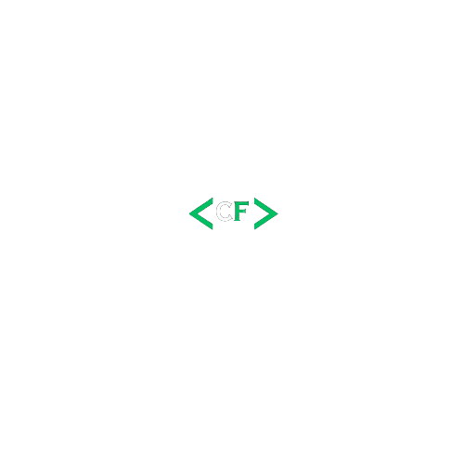




Coder Forge
Final Year Project (TYBCA)
Revolutionizing Online Learning
Presented By: Omkar Shejwal
Vinit Mahale

Slide 2

Overviwe
Omkar Shejwal
210105011037
Presented By
Introduction
Objectives and Goals
Project Scope
Progress Overview
Frontend & Backend UI
Frontend Development
Backend Development
Future Enhancements
Challenges Faced
Conclusion
Vinit Mahale
210105011029

Slide 3
Introduction
<CF>
Introducing Coder Forge : A platform revolutionizing online learning in programming.
Our mission is to provide accessible and interactive resources for learners of all levels.
Meet the team:
Omkar Shejwal
Vinit Mahale

Slide 4


Objectives and Goals
Objective 1: Enhance user learning experience
Objective 2: Provide accessible programming resources
Objective 3: Foster a supportive learning community

Slide 5



Project Scope
Frontend Development
Backend Development
Targeted Audience
Responsive UI/UX design, intuitive navigation
Secure user authentication, dynamic content management
Students, professionals, and enthusiasts interested in programming

Slide 6
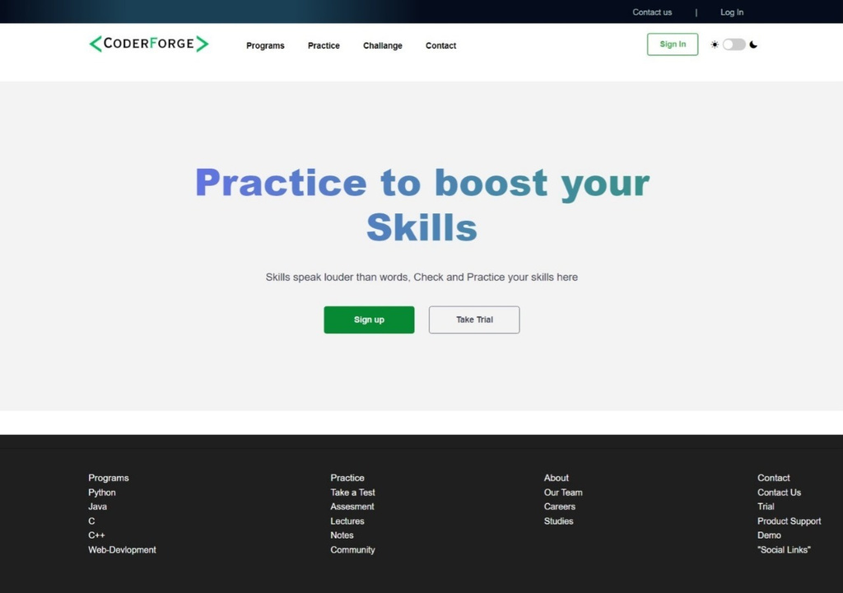
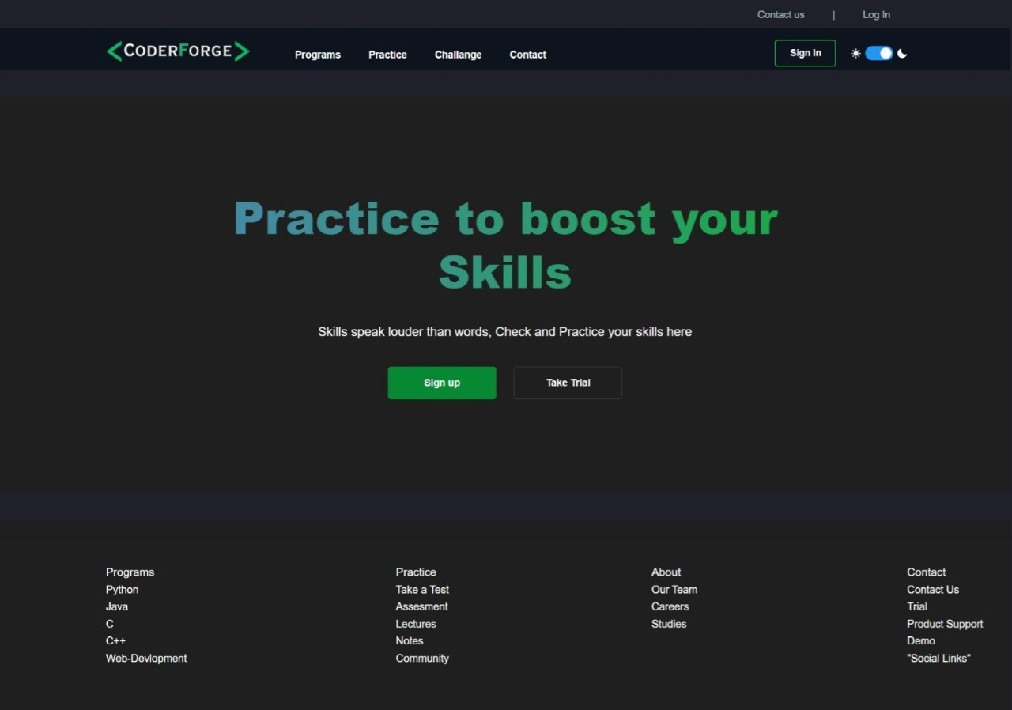
Frontend
Dash-Board
Dashboard [Light Mode]
Dashboard [Dark Mode]

Slide 7
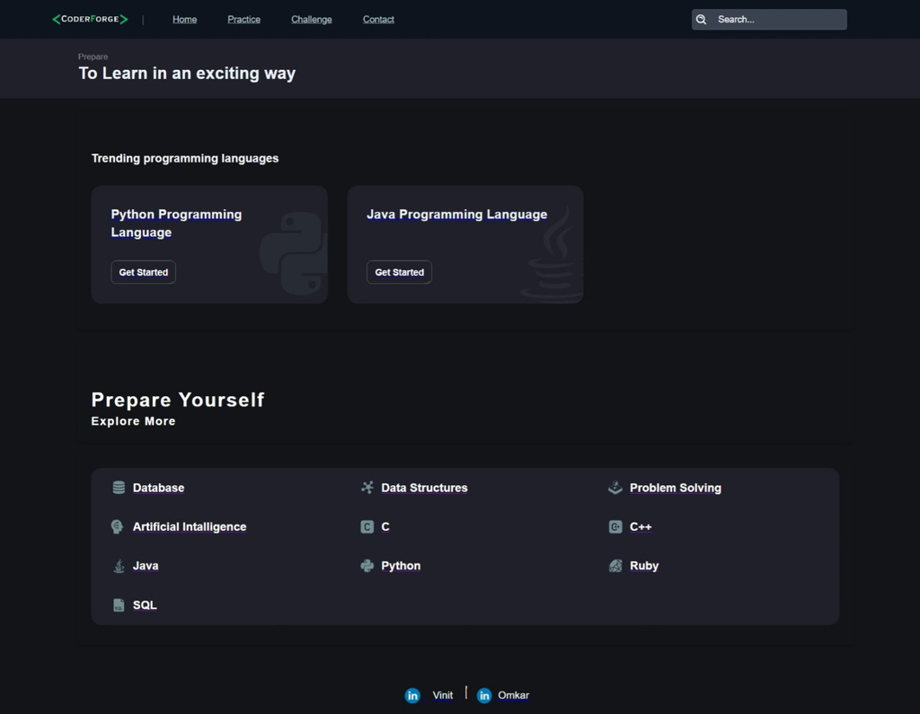
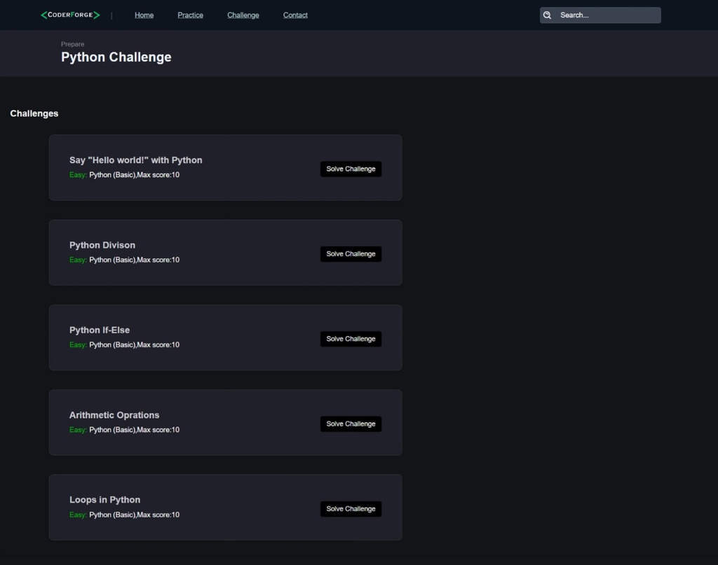
Frontend
Main Pages
Home Page
Test Questions

Slide 8
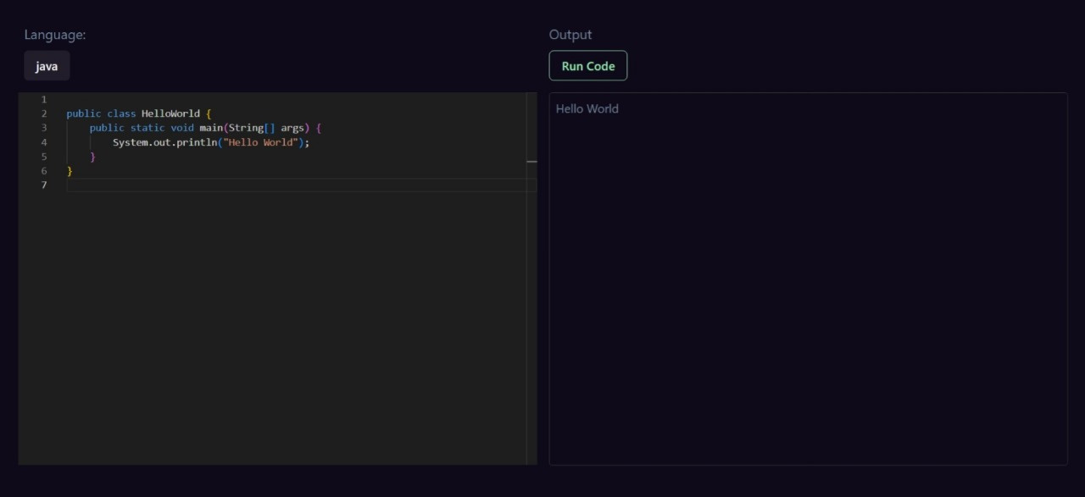
Frontend
Compiler

Slide 9
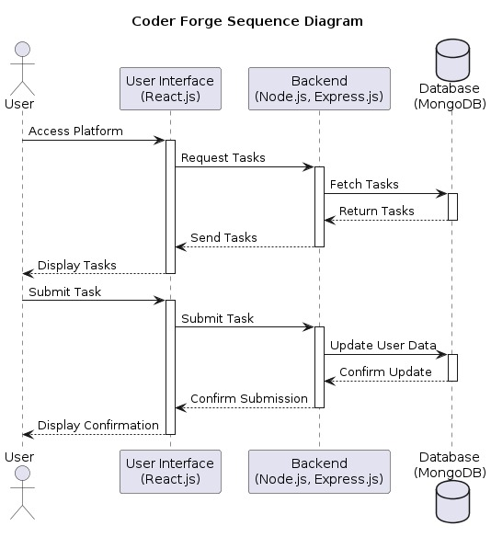
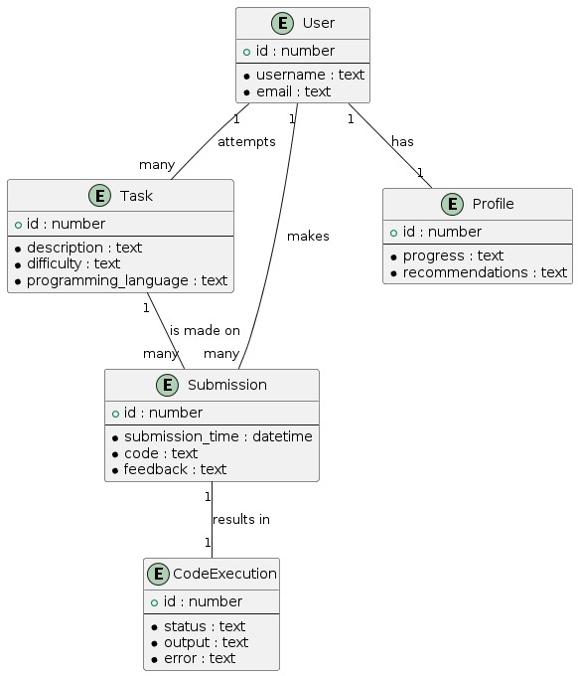
BackEnd
Complier And Data Base Integration
Sequence Diagram
ER Diagram

Slide 10


Progress Overview
Milestones Achieved
Frontend Integration
Backend Integration
Next Steps
Finalize backend integration, conduct testing, prepare for launch
Completed
Underway !

Slide 11
Frontend Development
Implemented responsive UI/UX design for seamless user experience across devices.
Developed intuitive navigation and user-friendly interface for easy exploration of content.
Integrated interactive elements to enhance user engagement and learning experience.

Slide 12

Backend Development
Established secure user authentication system to protect user data.
Implemented dynamic content management for seamless updates and additions.
Integrated APIs to enable communication between frontend and backend systems.

Slide 13




Future Enhancements
Introduction of advanced learning modules and interactive exercises.
Expansion of course offerings to cover a wider range of programming languages and topics.
Implementation of community features such as forums and peer-to-peer learning opportunities.

Slide 14

Challenges Faced
Challenges Faced:
Technical hurdles in implementing complex features.
Time constraints and project scope adjustments.
Coordination issues within the development team.
Strategies Employed:
Regular team meetings to discuss progress and address challenges.
Seeking external expertise and resources when needed.
Agile development approach to adapt to changing requirements.
Lessons Learned:
Importance of effective communication and collaboration.
Value of flexibility and adaptability in project management.
Continuous learning and improvement mindset.

Slide 15


Conclusion
Key Takeaways
Coder Forge has made significant progress in revolutionizing online learning.
We have successfully implemented frontend and backend functionalities to create a seamless user experience.
User feedback has been instrumental in shaping the project's direction and driving improvements.
Project Accomplishments
Developed user-friendly platform for programming enthusiasts of all levels.
Established a strong foundation for future enhancements and expansion.

Slide 16
Thank You
Thank you to our team members, contributors, and supporters for their hard work and dedication.
We look forward to continuing our journey of innovation and growth with Coder Forge.

